Slide 1



Slide 2
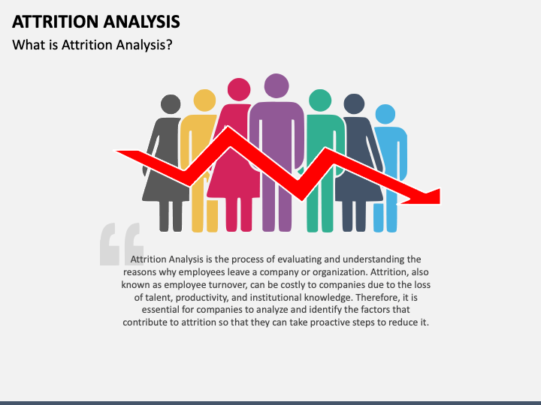
EMPLOYEE ATTRITION ANALYSIS
Presented By - (Group 2)
Atul
Akshay
Mohammad
Gayatri
Prabhleen
Pratiksha

Slide 3

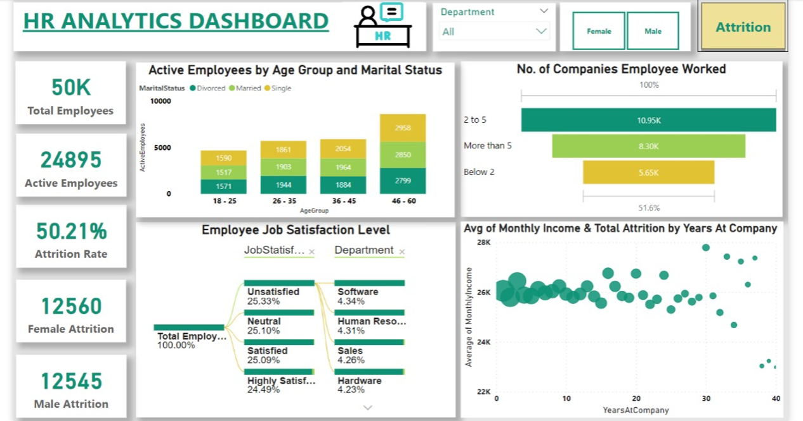
DASHBOARD - 1

Slide 4
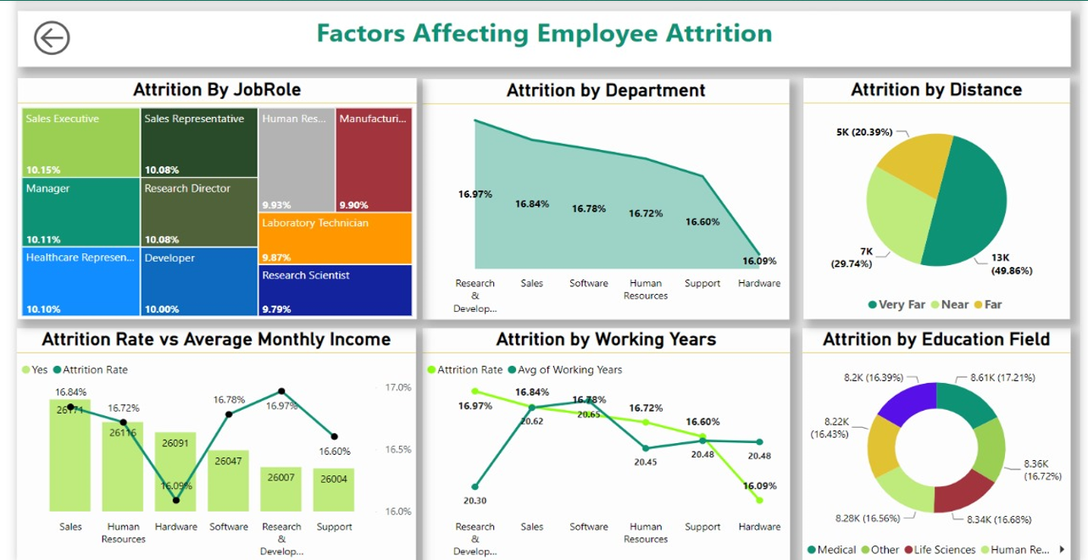
DASHBOARD - 2

Slide 5
Key Performance Indicators (KPIs)
Total Employees
50000
Active Employees
24895
Attrition Rate
50.21%
Female Attrition
12560
Male Attrition
12545

Slide 6
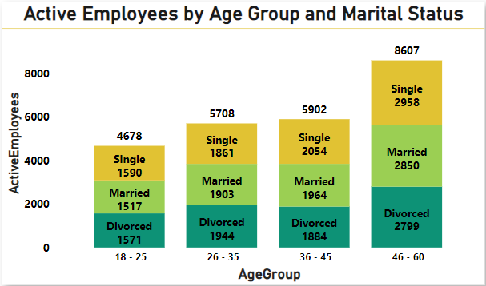
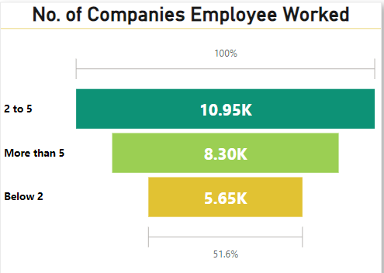
Lowest Count – 4678 employees in the age group of 18 to 25.
Highest Count – 8607 employees in the age group of 46 – 60.
This shows that employees of age group 46-60 age are more prone to attrition as this age group is nearer to retirement age.
Lowest Count – 5.65k employees who have worked in less than 2 companies.
Highest Count – 10.95k employees who have worked in 2 to 5 companies.
Working in different working environments aids to dynamic thoughts of different employees that foster the organization growth.

Slide 7
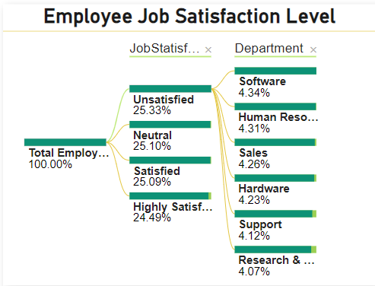
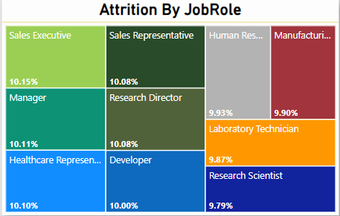
Out of Total 50000 employees, 25.33% employees are Unsatisfied with their jobs whereas 24.49% employees are Highly Satisfied with their jobs.
This shows that almost ¼ of Total employees are Unsatisfied with their Jobs.
Among different Job Roles the highest attrition rate of 10.15% is seen in Sales Executive Job Role. On the other hand Research Scientist Job Role has the lowest attrition rate of 9.79%. There is not much deviation seen.
However, a deeper analysis may be conducted to understand the specific factors contributing to attrition in different job roles.

Slide 8
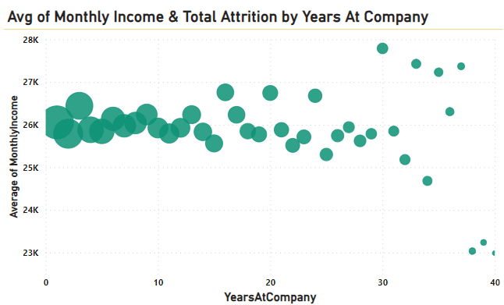
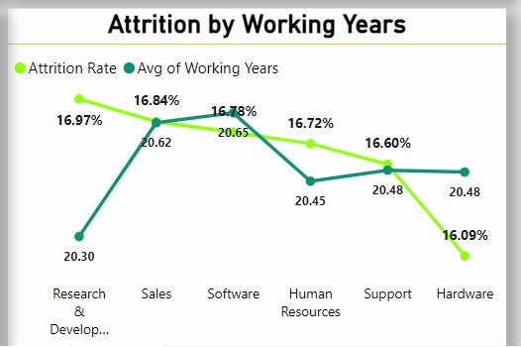
Higher attrition can be seen for the newly joined employees with many leaving the company within 1 year. Meanwhile a decreasing trend can be seen in attrition as the employees working years keep on increasing.
The overall average working years for all departments is 20.50. The R&D department has the highest attrition rate of 16.97% with lowest avg. working years 20.30. The lowest attrition rate (16.09%) is seen in Hardware department where avg. working years (20.48) is near to lowest value.

Slide 9
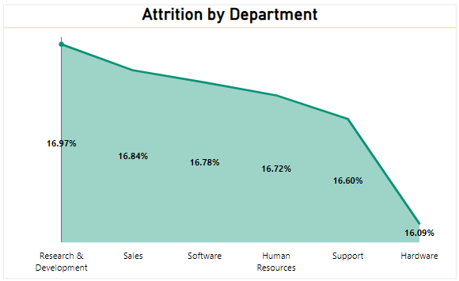
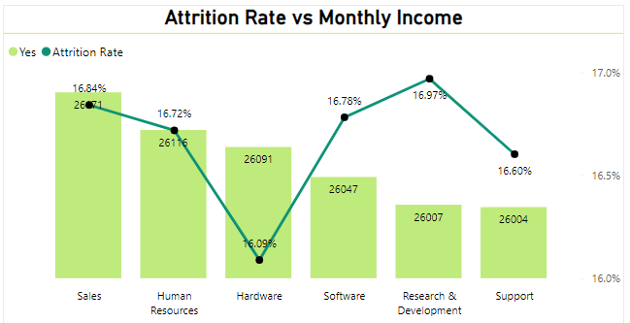
The average attrition ratio across all five departments falls within the range of 16.09% to 16.97%.
The R&D department exhibit the highest attrition rate of 16.97% while the Hardware department have relatively lower attrition of 16.09%.
The lowest avg. monthly income paid to employees has a high rate of attrition. R&D department is paying low salary of Rs. 26007 to employees and attrition rate is noted as 16.97%.
Low Monthly income of employees seems to be a reason behind high attrition.

Slide 10
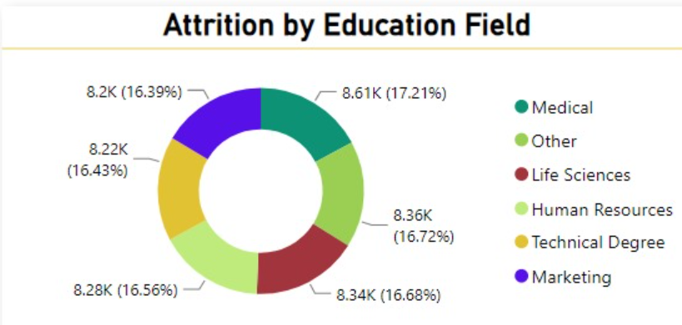
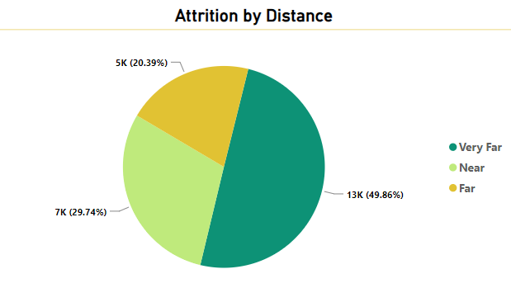
This visual shows us the Highest attrition for the people belonging to the Medical field which stands at 8.61k having a rate of 17.21%.
Special attention should be given for the employees belonging to the Medical field
This graph shows that almost half of total attrition (13k) is due to the highest percentage of 49.86% employees residing Very Far from Office as compared to the employees residing far or even near the office.
It indicates that majority of employees residing far from office are leaving the organization.

Slide 11

CONCLUSION OF ANALYSIS
As per the detailed analysis, the following conclusions may be drawn in terms of increased attrition rate:-
Attrition varies with different aspects like departments, income levels, tenure, education fields and commuting distances.
Employees from R&D department are leaving the company with high pace as compared to other departments which shows that R&D department needs improvement.
Employees getting low monthly income and unsatisfied with their jobs are leaving the company.
Furthermore the employees residing Very Far from office are not willing to commute as the long distance travel increases the travel time and travel expense.
By addressing the underlying causes of attrition, the company can work towards fostering a more stable and satisfied workforce.

Slide 12
SUGGESTIONS TO MAINTAIN OPTIMUM EMPLOYEE RETENTION
Employee Retention Strategies may be adopted by Management.
Provide a conducive working environment to employees.
Regular checks on workload of employees and reallocation of tasks, if needed.
Bi-monthly Performance analysis of all departments.
To Lower attrition level arising due to travel distance, accommodation or conveyances facilities / allowances may be provided to employees.
Monthly Income of employees commensurate with the market rates. Equal pay policy for same work maybe ensured.
Trainings / mentorship programs may be provided to employees for efficient working.

Slide 13

Thank You

